Slide 1
WeatheR ReactNative + OpenWeatherMap
Jose Cezar Ynion
Dinh Lieu

Slide 2
Project Description
Mobile app to display the current weather in your location or from any city you wish to search.

Slide 3

System Design Diagram
Rest API

Slide 4
Implementation
Views
OpenWeatherMap API
Geo location
HTTP Client

Slide 5
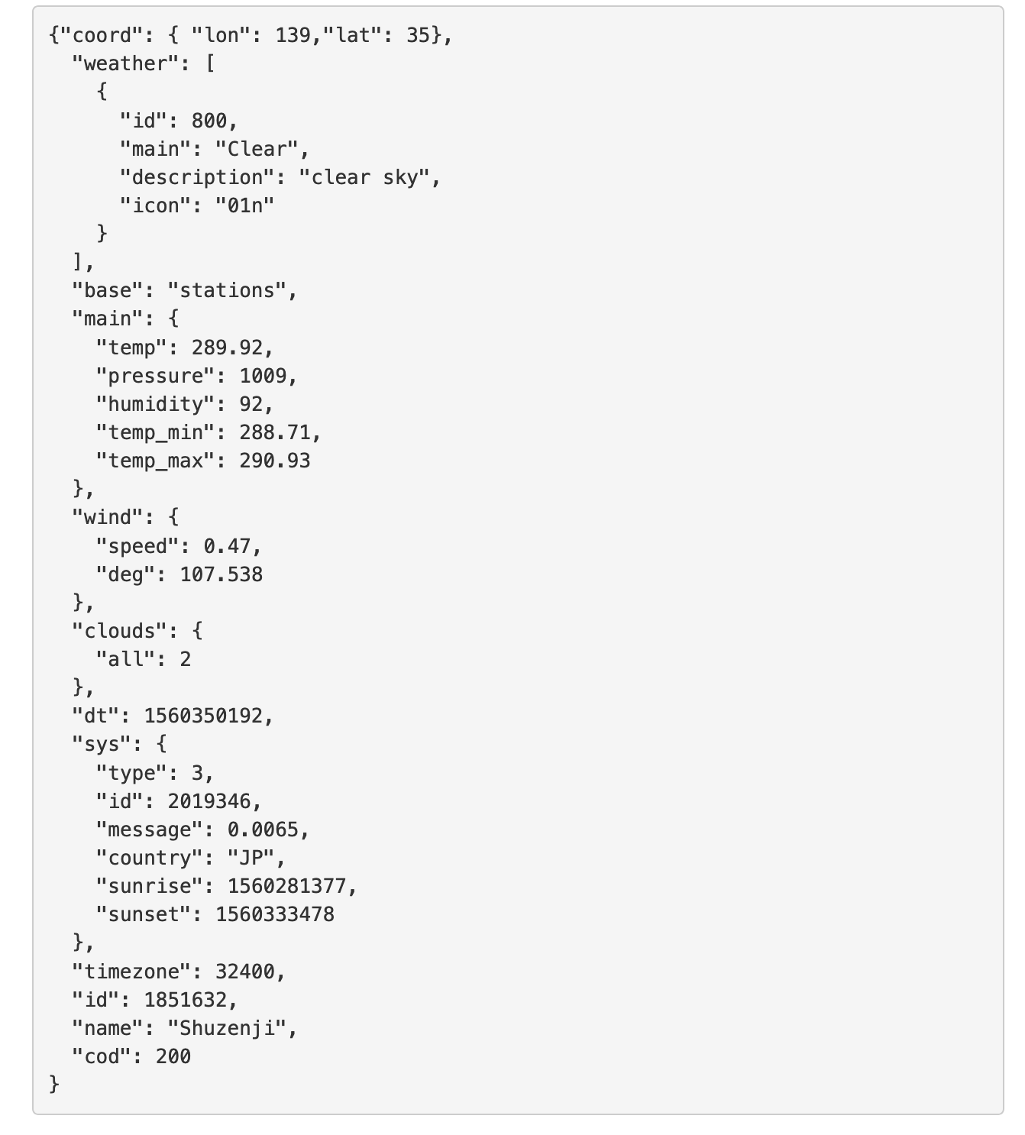
Implementation
OpenWeatherMap API usage
Pass geolocation
Pass city name
Get weather info
Get weather icon
Search a city
Source: https://openweathermap.org/api

Slide 6
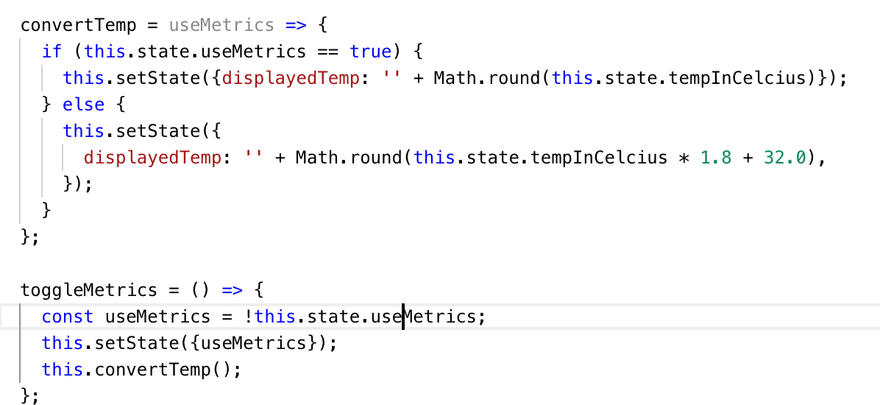
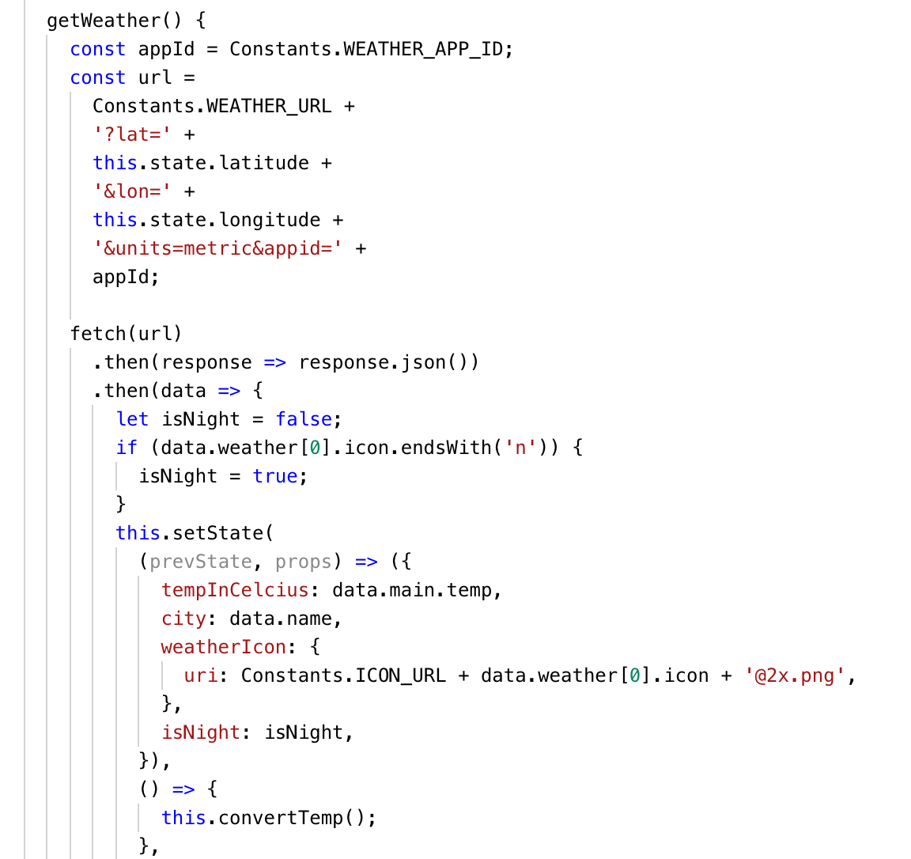
Implementation

Slide 7
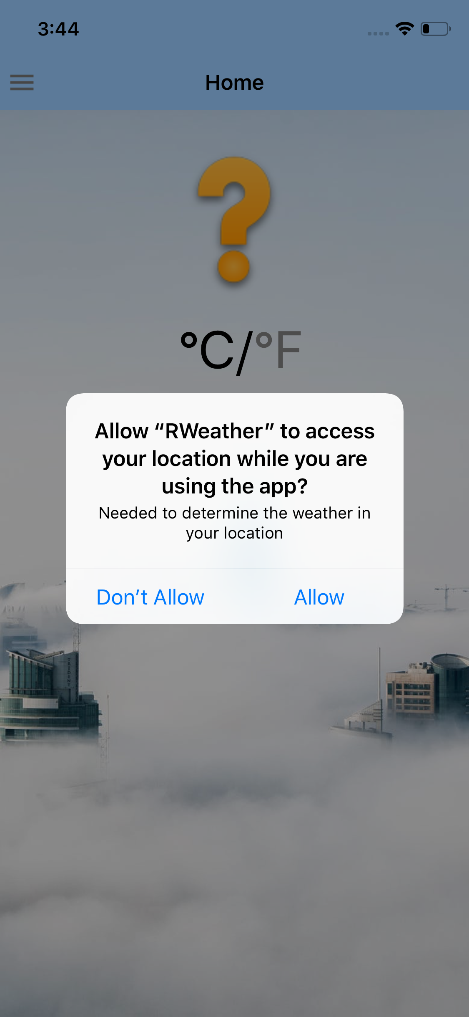

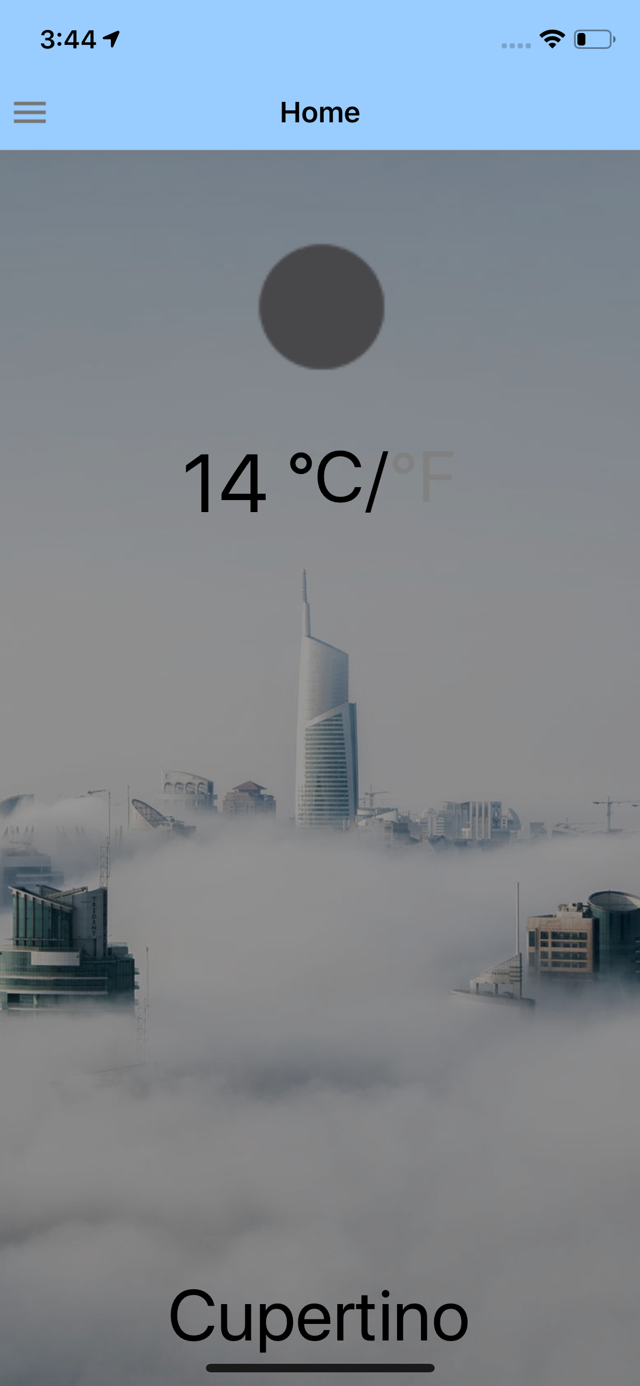

Screenshots of Test Runs

Slide 8
Conclusions
Pros
Fun to learn
Knowledge learned can be used later in web development, not just for mobile.
Cons
Need experience in ReactJS and Javascript
Not really for rapid development/prototyping. It is faster to develop an app natively.
Most errors/mistakes are in the development environment/tools.

Slide 9
Demo

Slide 10
Nice to haves
Picture of city as background
Map showing weather around a boxed location
The History View that contains all the searched cities

